Slide 1
Data Perikanan Kapuntori
Total landings
CPUE
Size Structure
Species Composition

Slide 2
Total Landings in MAR Kapuntori
40
30
Stable
Total landings(kg)
20
10
0
Nov 2019
May 2020
Nov 2020
May 2021
Nov 2021
May 2022
Nov 2022
May 2023
Nov 2023
May 2024
Nov 2024
May 2025
Nov 2025

Slide 3
Catch Per Unit Effort in MAR Kapuntori
10.0
7.5
CPUE (kg/fisher/trip)
5.0
Stable
2.5
0
Nov 2019
May 2020
Nov 2020
May 2021
Nov 2021
May 2022
Nov 2022
May 2023
Nov 2023
May 2024
Nov 2024
May 2025
Nov 2025

Slide 4
Katamba
Lethrinus lentjan

Slide 5
Total Landings L.lentjan in MAR Kapuntori
7.5
5.0
Stable
Total landings(kg)
2.5
0.0
Nov 2019
May 2020
Nov 2020
May 2021
Nov 2021
May 2022
Nov 2022
May 2023
Nov 2023
May 2024
Nov 2024
May 2025
Nov 2025

Slide 6
Catch Per Unit Effort L.lentjan in MAR Kapuntori
5
4
Stable
3
CPUE (kg/fisher/trip)
2
1
0
Nov 2019
May 2020
Nov 2020
May 2021
Nov 2021
May 2022
Nov 2022
May 2023
Nov 2023
May 2024
Nov 2024
May 2025
Nov 2025

Slide 7
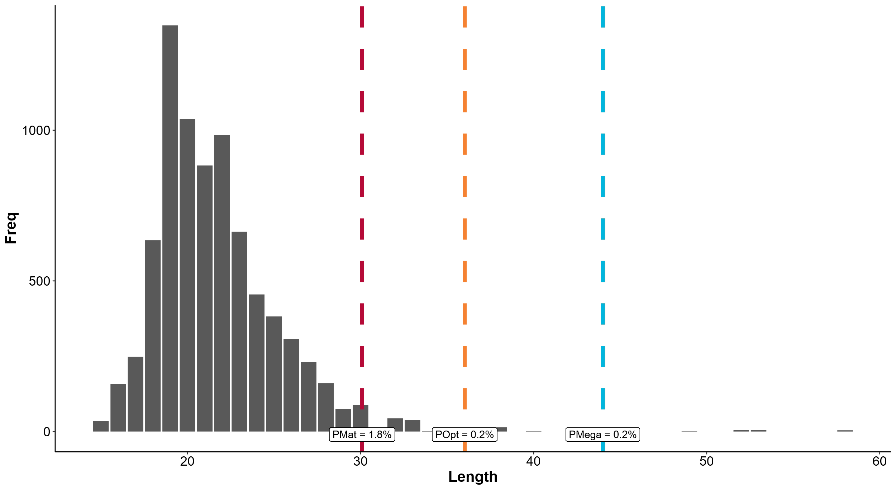

Slide 8
Mata Besar
Priacanthus macracanthus

Slide 9
Total Landings P.macracanthus in MAR Kapuntori
20
Decreased
15
Total landings(kg)
10
5
0
Nov 2019
May 2020
Nov 2020
May 2021
Nov 2021
May 2022
Nov 2022
May 2023
Nov 2023
May 2024
Nov 2024
May 2025
Nov 2025

Slide 10
Catch Per Unit Effort P.macracanthus in MAR Kapuntori
10.0
Decreased
7.5
CPUE (kg/fisher/trip)
5.0
2.5
0.0
Nov 2019
May 2020
Nov 2020
May 2021
Nov 2021
May 2022
Nov 2022
May 2023
Nov 2023
May 2024
Nov 2024
May 2025
Nov 2025

Slide 11
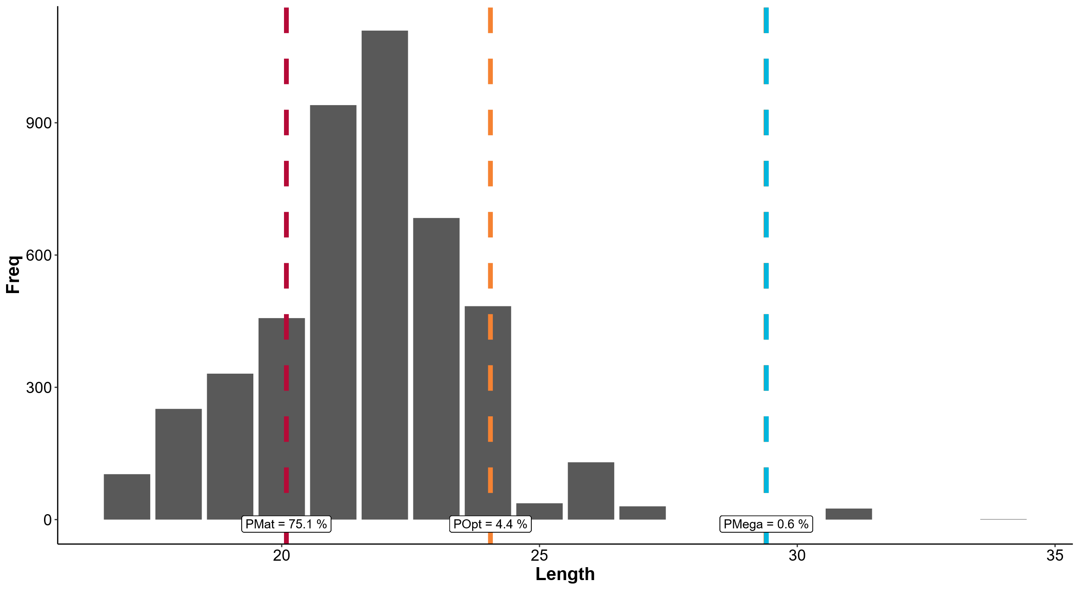

Slide 12
Mada
Lutjanus vitta

Slide 13
Total Landings L.vitta in MAR Kapuntori
5
Decreased
4
3
Total landings(kg)
2
1
0
Nov 2019
May 2020
Nov 2020
May 2021
Nov 2021
May 2022
Nov 2022
May 2023
Nov 2023
May 2024
Nov 2024
May 2025
Nov 2025

Slide 14
Catch Per Unit Effort L.vitta in MAR Kapuntori
4
3
Decreased
CPUE (kg/fisher/trip)
2
1
0
Nov 2019
May 2020
Nov 2020
May 2021
Nov 2021
May 2022
Nov 2022
May 2023
Nov 2023
May 2024
Nov 2024
May 2025
Nov 2025

Slide 15
